Slide 1
SMART BRIDGE SUMMER INTERNSHIP PROGRAM 2019
ASSERT FAILURE PREDICTION
(annamacharya institute of technologies and sciences, tirupathi)
By newbie team

Slide 2
Machine learning (ML) is a part of Artificial Intelligence.
In 1959,Arthur Samuel defined Machine Learning as a “Field of study that gives computers the ability to learn without being explicitly programmed”.
Machine Learning is classified into three categories . They are:
Supervised Learning
Unsupervised Learning
Reinforcement Learning

Slide 3
Types of supervised learning: regression model classification model
Regression model :
X and Y attributes have continuous values.
Predicting a quality.
Where X(input) is an Independent attribute and Y(output) is dependent attribute.
Classification model:
X have continues values and Y have binary values(0 or 1).
Predicting a label.
Where X(input) is an Independent attribute and Y(output) is dependent attribute.

Slide 4
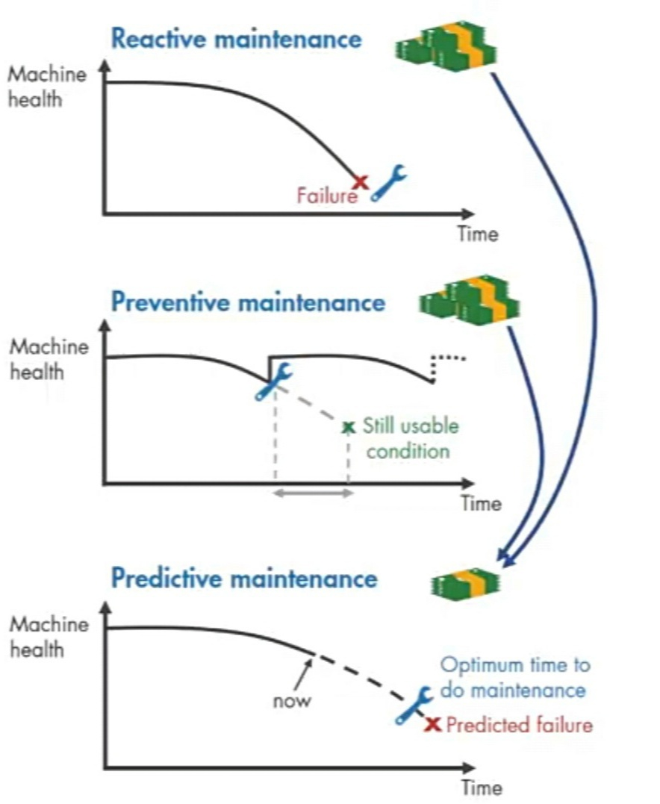
Assert Failure Prediction is to detect faults and predict failures

Slide 5
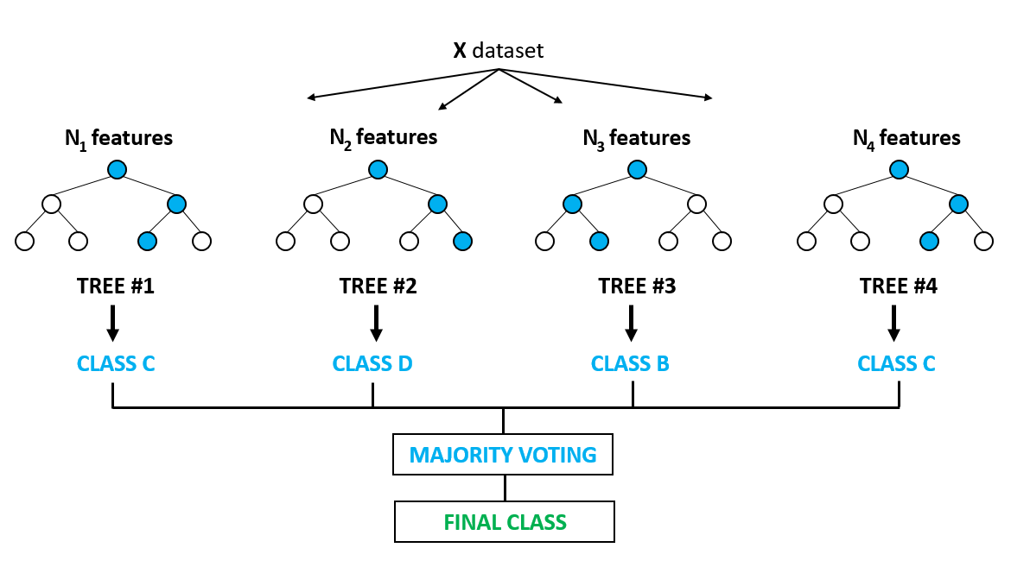
Model used: Random Forest Classifier.
Random Forest is an ensemble learning method for Classification and Regression.
It is a multitude of decision trees working together.
Using Random Forest Classifier :
Import Library
Create Model
Train
Predict

Slide 6
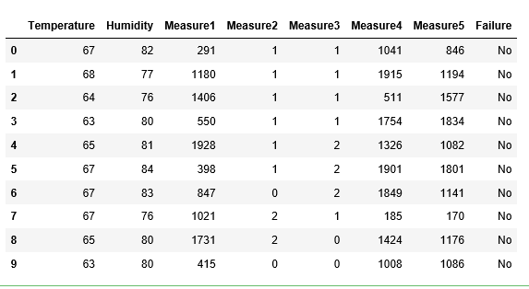
Sample dataset :
Method used:
Label Encoder (which converts a string into binary value) .

Slide 7
conclusion
Predicting the failure where it occurs in a machinery.
Based on the dataset we use the Random Forest Classifier model
Because of the associated risk and cost failure, early detection and prediction of fault is very imp.
The performance of a data driven methodology is dependent on the suitability of the data to the type of methodology to be applied.
However , for a model based methodology to work satisfactorily, the model must adequately describe system dynamics

Slide 8
Thank you
By NEWBIE Team

